Slide 1
Lecture 1: Introduction
Course Information
Introduction to DBMS
Key Concepts
History
United International College

Slide 2

Course Information
Course Information
Introduction to DBMS
Key Concepts
History
Text Book
Database System Concepts
Seventh Edition
Avi Silberschatz
Henry F. Korth
S. Sudarshan
McGraw-Hill Education
ISBN: 0073523321

Slide 3
Course Information
Course Information
Introduction to DBMS
Key Concepts
History
Contact and Timetable
Section | Instructor | TA | Time | Time | Venue
1001 1004 | Dr. Zhiyuan Li goliathli@uic.edu.cn T3-502-R6 | Mr. Shichen Zhang shichenzhang@uic.edu.cn T3-502-R26-H6 | Lec | Tue. 15:00-16:50 | T7-503
 |  |  | Lab | Mon. 15:00-15:50 | T4-301
 |  |  | Tut | Tue. 18:00-18:50 | T7-202
1002 1005 | Dr. Jefferson Fong jeffersonfong@uic.edu.cn T3-602-R1 | Ms. Lily Lin chengyanlin@uic.edu.cn T3-602-R25 | Lec | Wed. 10:00-11:50 | T7-503
 |  |  | Lab | Thu. 17:00-17:50 | T8-303
 |  |  | Tut | Wed. 12:00-12:50 | T5-604
1003 1006 | Dr. Tianhui Meng tianhuimeng@uic.edu.cn T6-403-R7 | Mr. Wenchuan Zhang t330201704@mail.uic.edu.cn V26-202 | Lec | Tue. 16:00-17:50 | T6-404
 |  |  | Lab | Fri. 9:00-9:50 | T29-101
 |  |  | Tut | Wed. 18:00-18:50 | T29-301

Slide 4
Course assessment
Course Information
Introduction to DBMS
Key Concepts
History
3 Assignments: 10%
Midterm: 20%
Lab: 10%
Group project: 20%
Final Exam: 40%

Slide 5
Course assessment
Course Information
Introduction to DBMS
Key Concepts
History
Regulations
MR sections and FE sections will be graded separately.
Low final exam score will downgrade the letter grade.
Final Exam Score | Highest Letter Grade
0 - 19 | F
20 - 24 | D
25 - 29 | C-

Slide 6
Lecture Weekly Schedule
Course Information
Introduction to DBMS
Key Concepts
History
Week | Lecture | Readings | Lab
1 | 1. Introduction | Chap. 1 | 1. XAMPP
2 | 2. Basic ER model | Chap. 6.1-3, 6.5 | 2. Basic Query
3 | 3. ER Constraints | Chap. 6.4 | 3. Cross Table Queries
4 | 4. Extended ER | Chap. 6.5.3, 6.8 | 4. Join
5 | 5. ER Design Issues | Chap. 6.9 | 5. Aggregation
6 | 6. Relational Model | Chap. 2.1-4, 6.8.6 | 6. Data Definition
7 | 7. Exercises | - | 7. Data Modification
8 | Reading Week
9 | 8. Design Purpose | Chap. 7.1 | 8. Null Values & Subquery 1
10 | 9. Functional Dependencies | Chap. 7.4 | 9. Set Operations & Subquery 2
11 | 10. BCNF | Chap. 7.3, 7.5 | 10. Correlation
12 | 11. 3NF | Chap. 7.3, 7.5 | 11. Foreign key & Triggers
13 | 12. MVDs (Optional) | Chap. 7.6 | 12. Constraints
14 | 13. XML Database | Chap. 30 | 13. Triggers
15 | Project Presentation | -

Slide 7

Introduction to Databases
Course Information
Introduction to DBMS
Key Concepts
History
Whether you know it or not, you're using a database every day

Slide 8

Database Management System (DBMS)
Course Information
Introduction to DBMS
Key Concepts
History
Database Applications
Banking: transactions
Airlines: reservations, schedules
Universities: registration, grades
Sales: customers, products, purchases
Online retailers: order tracking, customized recommendations
Manufacturing: production, inventory, orders, supply chain
Human resources: employee records, salaries, tax deductions
Social media sites: posts, friendship relationship, activities
Database can be very large.
Database touch all aspects of our lives.

Slide 9
University Database Example
Course Information
Introduction to DBMS
Key Concepts
History
Course Management
Add students, instructors, and courses
Register students for courses, and generate class rosters
Assign grades to students, compute grade point averages (GPA) and generate transcripts
Provide basic features necessary for data access
Shared access by a community of uses
Well-defined schema for data access
Support query language

Slide 10
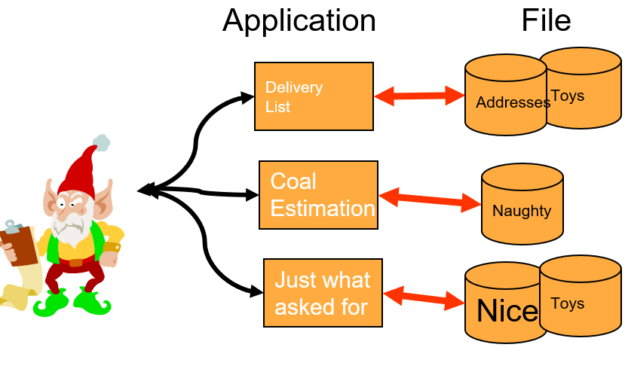
File systems
Course Information
Introduction to DBMS
Key Concepts
History
In the early days, applications were built directly on top of file systems.
Toys
Delivery List
Addresses
Coal Estimation
Naughty
Just what asked for
Nice
Toys

Slide 11
Drawbacks of file systems
Course Information
Introduction to DBMS
Key Concepts
History
Data redundancy and inconsistency
Multiple file formats, duplication of information in different files.
Difficulty in accessing data
Need to write a new program to carry out each new task.
Data isolation
Multiple files and formats
Integrity problems
Integrity constraints (e.g., account balance ≥ 0) become buried in program code rather than being stated explicitly.
Hard to add new constraints or change existing ones.

Slide 12
Drawbacks of file systems
Course Information
Introduction to DBMS
Key Concepts
History
Atomicity of updates
Failures may leave database in an inconsistent state with partial updates carried out.
Example: Transfer of funds from one account to another should either complete or not happen at all.
Concurrent access by multiple users
Concurrent access needed for performance
Uncontrolled concurrent accesses can lead to inconsistencies
Example: Two students want to choose the same course that has only one vacancy left.
Security problems
Hard to provide user access to some, but not all, data
Database system offer solutions to all the above problems.

Slide 13
DBMS provides…
Course Information
Introduction to DBMS
Key Concepts
History
Efficient
Reliable
Convenient
Safe
Multi-user (Storage of and access to)
Massive amounts of persistent data

Slide 14
In general
Course Information
Introduction to DBMS
Key Concepts
History
Big
Data
Data
accumulation
Data acquisition
Data
Database
Data Management
and
Applications
Find the value through data mining

Slide 15
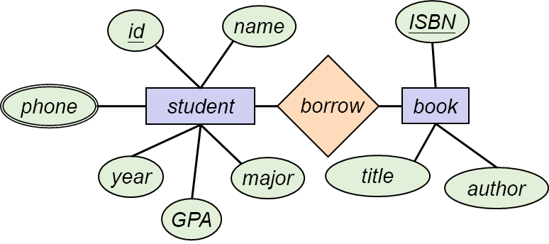
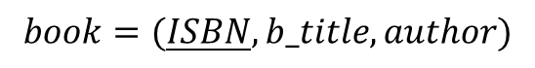
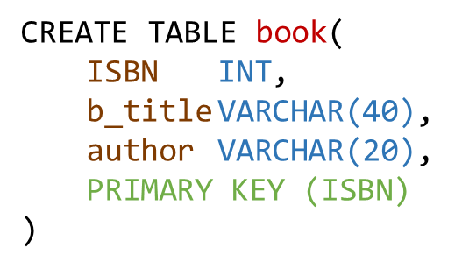


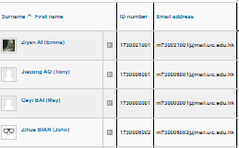
Key Concepts
Course Information
Introduction to DBMS
Key Concepts
History
Physical World
Abstraction
Information
(Conceptual Model)
Database Design
Computer World
(Relational Model)
Data Definition
(DDL)
Database
Schema
Data Manipulation
(SQL)
Database
Applications

Slide 16
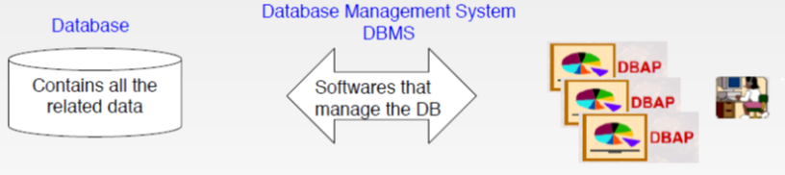
Key Concepts
Course Information
Introduction to DBMS
Key Concepts
History
Data modeling
Schema vs. Data instances
Data definition language (DDL)
Data manipulation or query language (DML)
DBMS implementer
Database designer
Database application developer
Database administrator

Slide 17
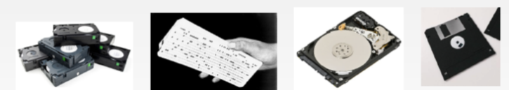
History of Database Systems
Course Information
Introduction to DBMS
Key Concepts
History
1950s and early 1960s:
Data processing using magnetic tapes for storage
Tapes provide only sequential access
Punched cards for input
Late 1960s and 1970s:
Hard disks allow direct access to data
Network and hierarchical data models in widespread use
Ted Codd defines the relational data model
Would win the ACM Turing Award for this work
IBM Research begins System R prototype
UC Berkeley begins Ingres prototype

Slide 18
History (cont.)
Course Information
Introduction to DBMS
Key Concepts
History
1980s:
Research relational prototypes evolve into commercial systems
SQL becomes industrial standard
Parallel and distributed database systems
Object-oriented database systems
1990s:
Large decision support and data-mining applications
Large multi-terabyte data warehouses
Emergence of Web commerce
2000s:
XML and XQuery standards
Automated database administration

Slide 19
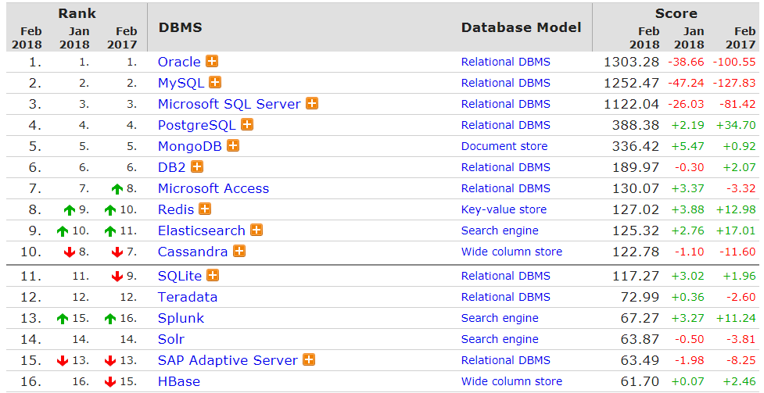
Database Popularity Rank 2017 - 2018
Course Information
Introduction to DBMS
Key Concepts
History

Slide 20
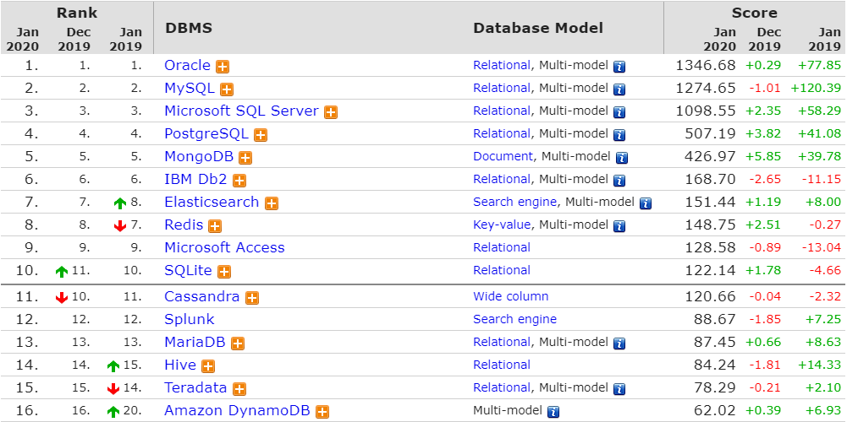
Database Popularity Rank 2019 - 2020
Course Information
Introduction to DBMS
Key Concepts
History

Slide 21
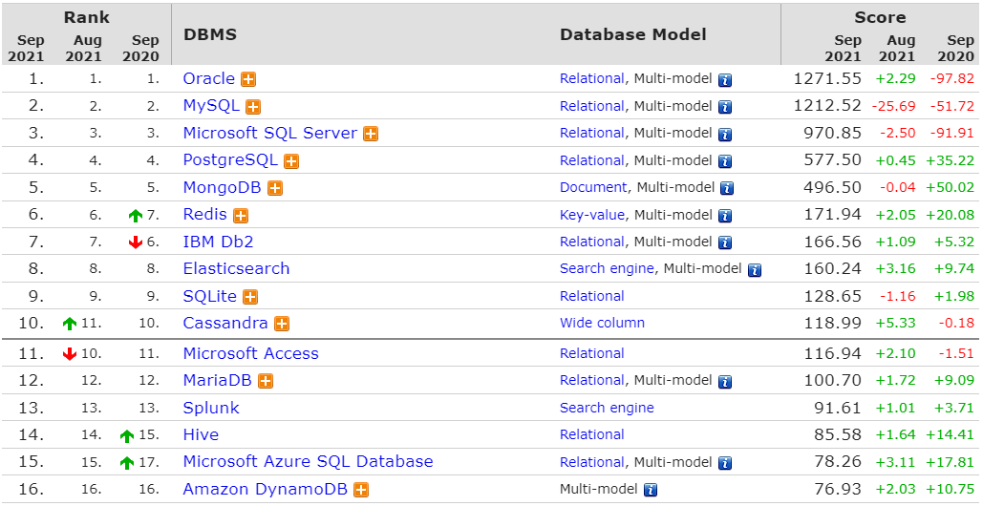
Database Popularity Rank 2020 - 2021
Course Information
Introduction to DBMS
Key Concepts
History

Slide 22
End of Chapter 1
Course Information
Introduction to DBMS
Key Concepts
History

